Slide 1
…

Slide 2


Slide 3
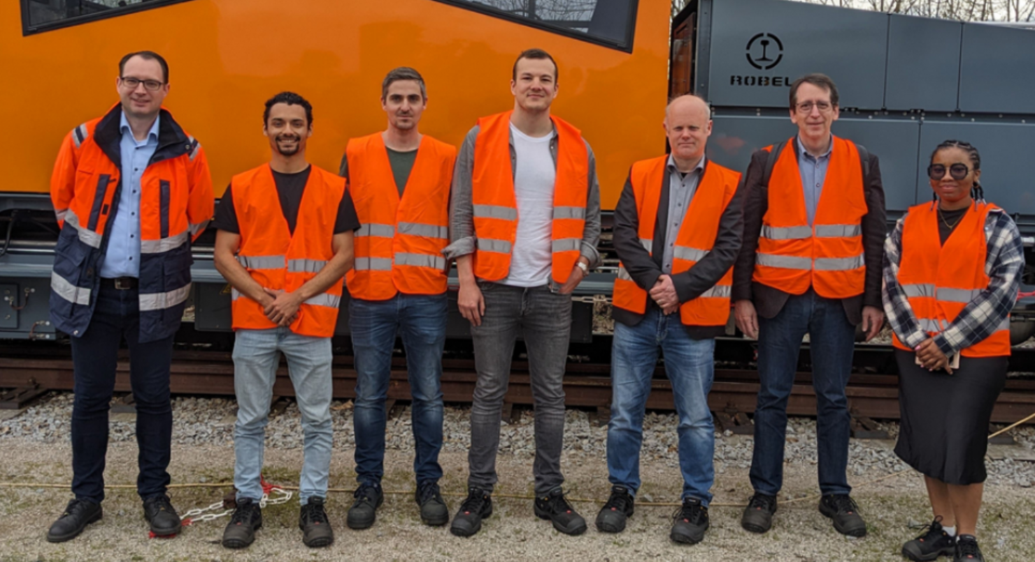

Slide 4





Slide 5





Slide 6


Slide 7




Slide 8



Slide 9
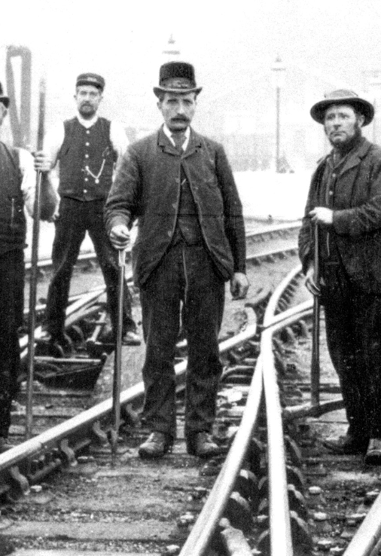

Keeping Railways on Track since 1875

Slide 10
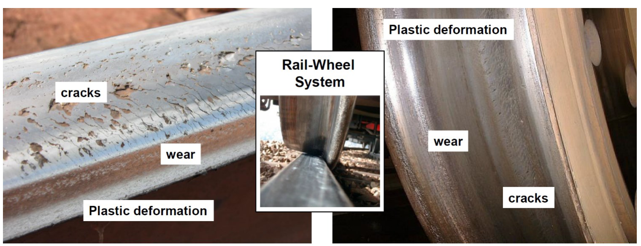

Slide 11
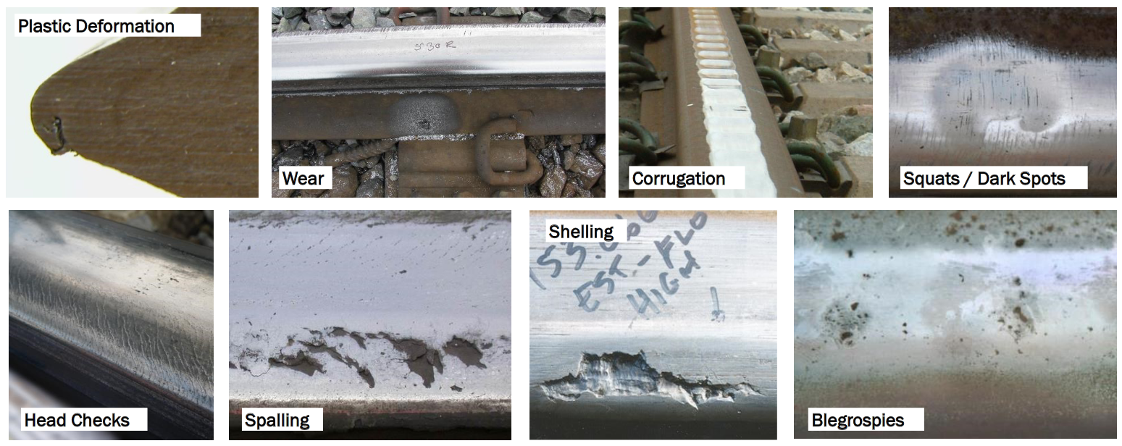

Slide 12
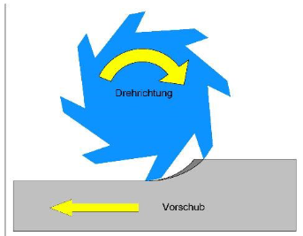
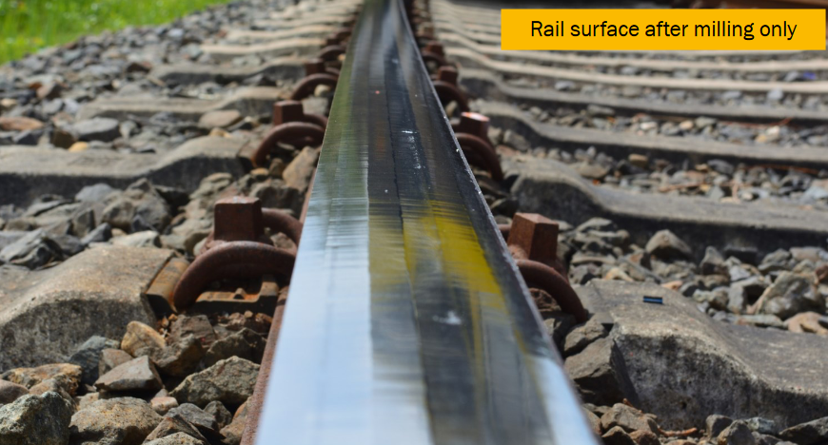

Slide 13
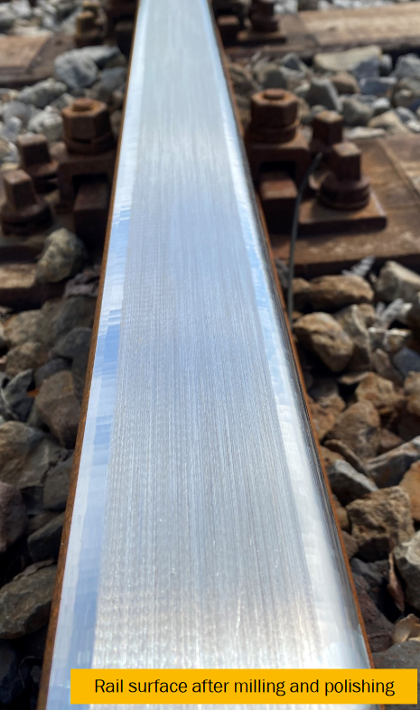

Slide 14
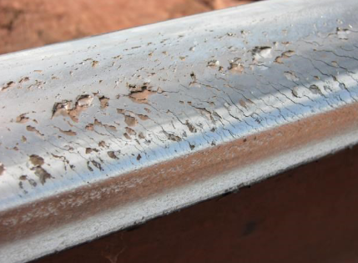

Slide 15
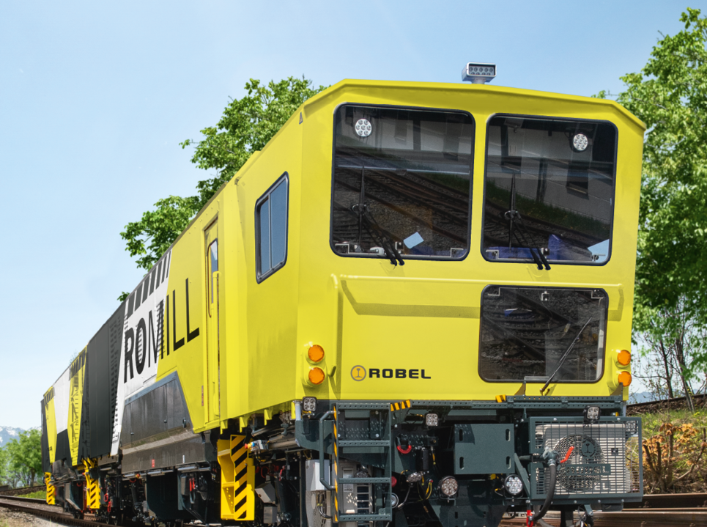

Slide 16
Challenge because…
4 years of data
+700 columns
total freedom

Slide 17
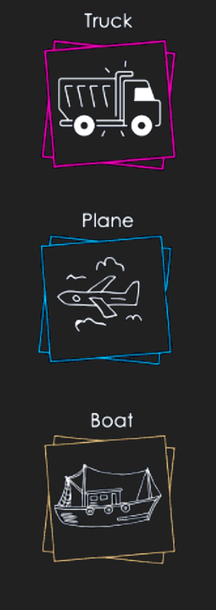

Train milling
Train travelling
Train inoperative

Slide 18
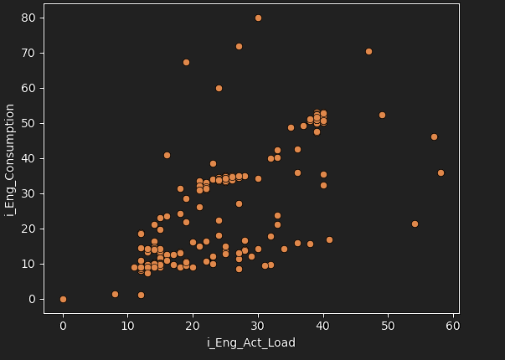
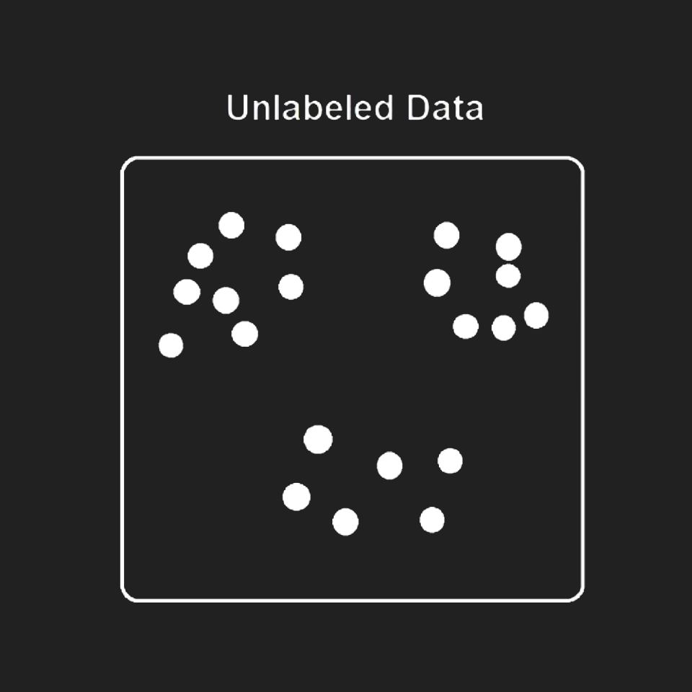
Unlabeled

Slide 19
Unlabeled
Labeled

Slide 20
?
Unlabeled
Labeled

Slide 21
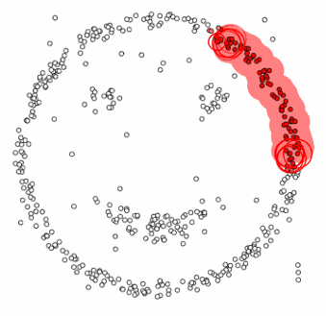
HDBScan

Slide 22
Unlabeled
Labeled
HDBScan

Slide 23
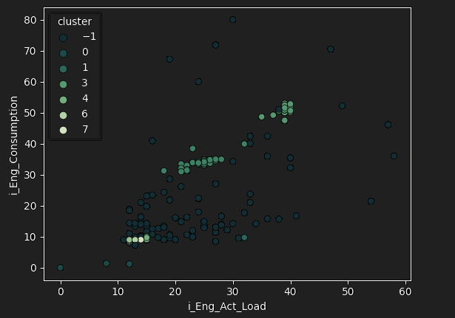
Unlabeled
Labeled
HDBScan

Slide 24



Train milling
Clustering
Unlabeled
Labeled
Train travelling
HDBScan
Train inoperative
Zzz…

Slide 25
Train milling
Clustering
Classification
Unlabeled
Labeled
Train travelling
?
HDBScan
Train inoperative
Zzz…

Slide 26
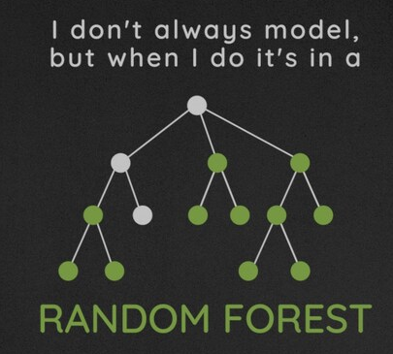

Slide 28
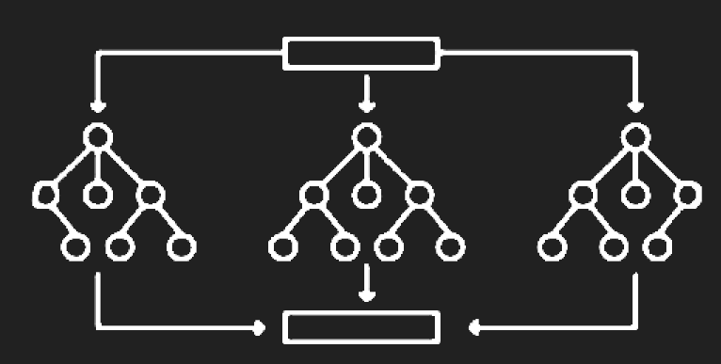
Train milling
Clustering
Classification
Unlabeled
Labeled
Train travelling
HDBScan
Train inoperative
Zzz…

Slide 29
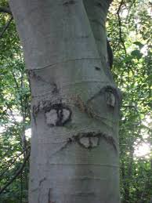
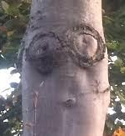
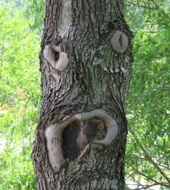
Train milling
Clustering
Classification
Unlabeled
Labeled
Train travelling
HDBScan
Train inoperative
Zzz…

Slide 30
Train milling
Clustering
Classification
Unlabeled
Labeled
Train travelling
HDBScan
Train inoperative
Zzz…
99.5%

Slide 31
Conclusion

Slide 32
?

Slide 33


Your data can fit so many DS/ML algorithms
Us

Slide 34
Received Unorganized Data

Slide 35
Received Unorganized Data
Labeled it through Clustering

Slide 36
Received Unorganized Data
Labeled it through Clustering
Built a Classifier

Slide 37
Received Unorganized Data
Labeled it through Clustering
Built a Classifier
Classify new data

Slide 38
Received Unorganized Data
Labeled it through Clustering
Built a Classifier
Classify new data
$$ Profit $$

Slide 40
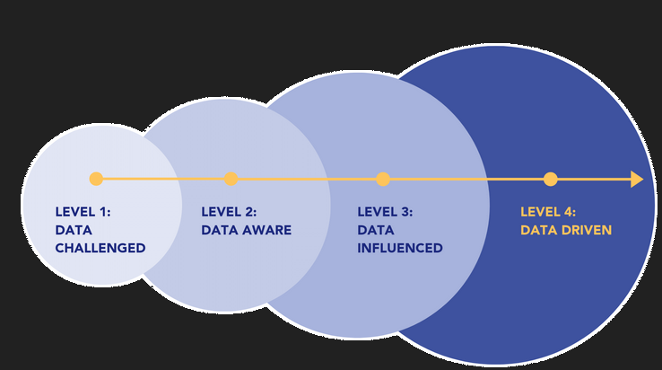

Slide 42


Slide 43


Slide 44


